Slide 1
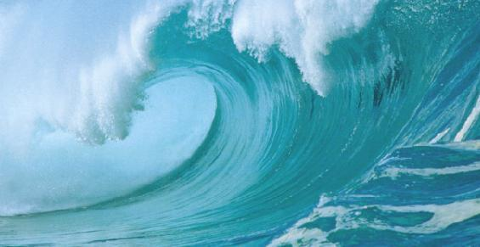
Ocean Motions

Slide 2
Wave Actions

Slide 3
Waves
A ______ is the movement of energy through a body of water.
Most waves form when winds blowing across the water’s surface transmit their energy into the water.
Waves start in the open ocean and their size depends on the strength and duration of the wind:
Gentle breeze = small ripples
Strong wind = large waves
wave
WAVES

Slide 4
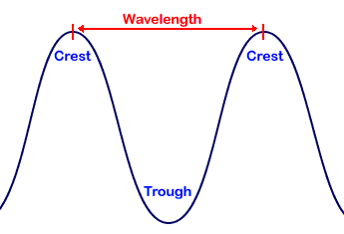
Describing Waves
The highest part of a wave is called the _______.
The lowest part of a wave is called the ________.
The horizontal distance between crests is the ____________.
The vertical distance from crest to trough is the ____________.
Wave _____________ is the number of waves that pass a point in a certain amount of time.
crest
trough
Wave height
wavelength
wave height
frequency

Slide 5
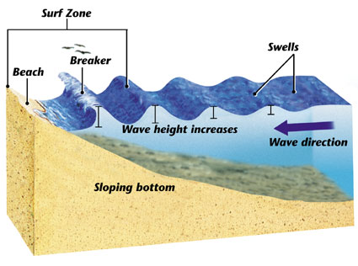
The shape & size of waves…
Deep water waves are long and low and are called _______.
Near the shore, the wave height increases and the wavelength decreases.
swells

Slide 6
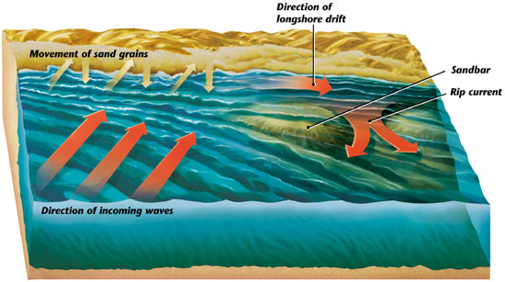
Waves at the Shore
The movement of water and sand along the beach, caused by waves, is called _______________.
As the waves slow down, they drop their sediment (sand), which forms a long, underwater ridge called a _________.
When a sandbar traps water flowing along the shore, it can create a ___________.
A rip current is a rush of water that flows rapidly back to sea through a narrow opening.
longshore drift
sandbar
rip current

Slide 7
Beach Erosion
Beach Erosion
Many people enjoy living or vacationing at the beach, but over time erosion can wear the beach away.
There a several ways to prevent beach erosion. A popular method is to build a _______. A groin is a wall of rocks or concrete built outward from the beach. Sand piles up against it instead of moving down shore.
groin

Slide 8
Tides

Slide 9
What causes tides?
The daily rise and fall of Earth’s waters on its coastlines are called _______.
When the water reaches its highest point, it is called high tide.
Lowest point = low tide.
Tides are caused by the interaction of Earth, the moon, and the sun.
How does something so far away, like the moon or the sun, affect the tides?
Gravity is the force exerted by an object that pulls another object.
tides
Gravity!!

Slide 10
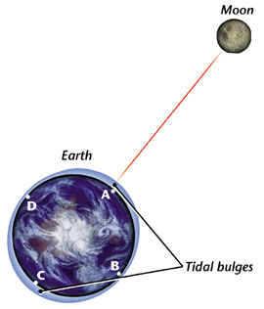
Gravity & The Tides
Gravity keeps everything around you on Earth’s surface, but the force of gravity is weaker as the distance between the objects increase (further away = less gravity).
The moon’s gravity has a big effect on Earth’s water. The moon pulls on the water on the side closest to it more strongly than it does on the center of the Earth, creating a tidal bulge.
The water on the opposite side is being pulled less strongly than Earth, so it is “left behind,” leaving a second tidal bulge.

Slide 11
Daily Tides
As the Earth turns completely around once each day, the tide rises and falls.
The high tide occurs about every 12 hours and 25 minutes.
Some areas experience big differences in their high tide and low tides.
Other areas do not experience a big difference between high tide and low tide. Several factors affect this:
Landforms (capes, peninsulas, and islands) interrupt water movements.
A basin at the mouth of a river

Slide 12
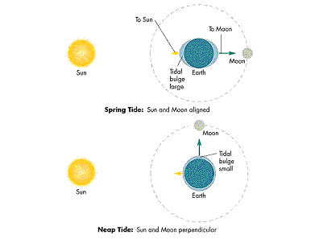
Monthly Tides
Even though the sun is 150 million km away it is so big that its gravity affects Earth’s tides!
The positions of the Earth, moon, and sun directly affect the tides:
Twice a month, at the new moon and the full moon, the sun and moon are lined up. Their combined gravitational pull produces the greatest difference between high tide and low tide.
At the 1st and 3rd quarter moons, the sun and moon pull at right angles to each other. This produces the least difference between high tide and low tide.
SPRING
TIDE
NEAP
TIDE

Slide 13
Ocean Water Chemistry

Slide 14
Why is the ocean salty?
If you’re swimming in the ocean and you swallow a little water, how will it taste?
Why??
Early in Earth’s formation, the ocean covered most, if not all, of Earth’s surface.
Underwater volcanoes erupted, spewing chemicals into the water.
Eventually the lava built up and formed land.
Rain fell onto the land and ran-off into the ocean, carrying still more of those chemicals with it.
Salty!!

Slide 15
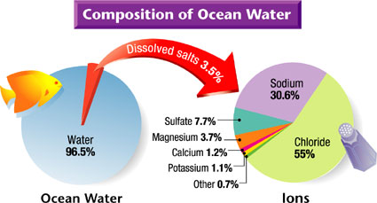
Salinity
The total amount of dissolved salts in water is called _________.
One kilogram of ocean water contains about 35 grams of salts (about 35 parts per 1,000).
Table salt (sodium chloride) is the salt that is most abundant in the ocean.
When sodium chloride dissolves in water, it separates into sodium particles and chloride particles(ions).
86% of the ions dissolved in ocean water are either sodium or chloride.
salinity

Slide 16
Variations in Salinity
In most parts of the ocean, the salinity is between 34 and 37 parts per thousand.
Some places salinity is lower:
Near the surface (precipitation, melting ice)
Near the mouth of large rivers
Some places salinity is higher:
Warm climates where water evaporates (Red Sea)
Near the poles where surface water freezes

Slide 17
Effects of Salinity
Freezing
Ocean water does not freeze until -1.9°C
The salt acts like antifreeze to the formation of ice crystals
Buoyancy
Salt water has a higher density than fresh water
Because of this, seawater has a high buoyancy than fresh water. It lifts less dense objects floating in it…
An egg floats higher in salt water than fresh water
It is easier to swim in the ocean than in a lake.

Slide 18
Temperatures in Ocean Water
The broad surface of the ocean absorbs energy from the _____.
Warm water is less dense than cold water, so the warm water stays near the surface.
Near the equator, the ocean’s surface about room temperature.
But as you dive deeper…big changes happen!
sun

Slide 19
Changes with Depth
As you descend from the surface to the ocean floor, you pass through the water column.
Temperature decreases (three zones)
Surface zone (surface to between 100 and 500 m)
Transition zone (bottom of the surface zone to approximately 1 km)
Temperature drops very quickly in the transition zone!
Decreases to about 4°C
Deep Zone (below the transition zone)
Coldest area of the ocean.
3.5°C or colder.
Pressure increases as you get closer to the ocean floor.

Slide 20
Currents & Climates

Slide 21
Currents
A ________ is a large stream of moving water that flows through oceans.
Unlike waves currents carry water great distances.
There are two types of currents:
Surface
Deep
current

Slide 22
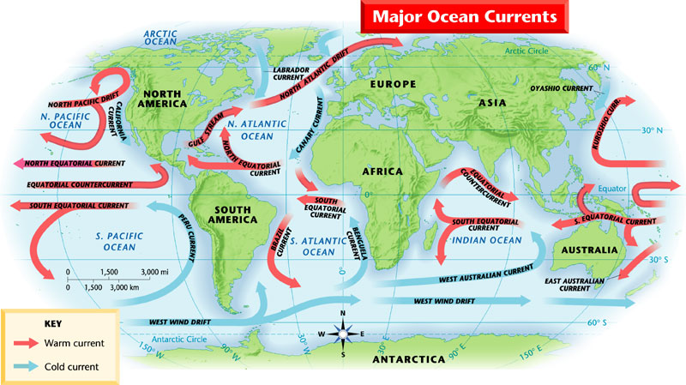
Surface Currents
Surface currents (to a depth of several hundred meters) are mainly driven by winds.
Follow the major wind patterns
Move in circular patterns - why?
The Coriolis effect is the effect of Earth’s rotation on the direction of winds and currents.
In the Northern hemisphere, the Coriolis effect causes currents to curve to the right.
In the Southern hemisphere, the Coriolis effect causes currents to curve to the left.
The Coriolis effect!

Slide 23
The Gulf Stream
The largest and most powerful surface current is the Gulf Stream.
In the North Atlantic Ocean
Caused by strong winds form the west
30 km wide & 300 km deep
Carries a volume of water 100 times greater than the Mississippi River
Carries warm water from the Gulf of Mexico to the Caribbean Sea, then north along the coast of the U.S.

Slide 24
Surface Currents & Climate
Climate is the pattern of temperature and precipitation typical of an area over a long period of time.
Currents affect climate by moving cold and warm water around the globe.
Currents carry warm water from the tropics towards the poles and then _____ water from the poles toward the equator.
Surface currents affect the air above it, which influence the climate of the land near the coast.
cold

Slide 25
Deep Currents
Deep below the surface another type of current causes chilly waters at the bottom of the ocean to creep slowly across the floor.
Deep currents are caused by differences in density rather than surface winds.
The density of water depends on its temperature and salinity.
When warm water from the equator cools off near the poles.
As ice forms near the poles, the salinity of the water increases.
The decreased temperature and increased salinity = denser water. Denser water sinks to the ocean floor.
Deep water currents move and mix water around the world; carrying cold water from the poles to the equator.
Deep currents move very slowly, taking as long as 1,000 years to make the trip from the pole to the equator!

Slide 26
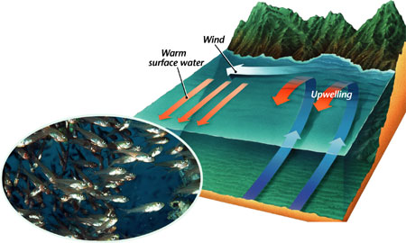
Upwelling
Typically, surface waters don’t mix with deep waters in the ocean.
Mixing happens near the poles, where surface waters cool, sink, and form deep currents.
Mixing also happens when winds cause upwelling.
Upwelling is the upward movement of cold water from the ocean depths.
As wind blows away warm surface water, cold water rises to replace it.
Upwelling brings up tiny organisms, minerals, and nutrients from the deep ocean.
Without upwelling, surface waters would not have the nutrients that fish need.

Slide 27
El Niño
Changes in winds and currents can greatly impact the oceans and the land near it.
El Niño is an abnormal climate event that happens every 2-7 years in the Pacific Ocean.
An unusual pattern of winds form over the western Pacific, causing a huge amounts of warm water to move east toward South America.
El Niño’s impact prevents upwelling near South America.
No upwelling = no nutrients for fish = fish die or leave = no food for birds.
El Niño has effects on the land, too.
Because the water and wind affect the climate, El Niño can cause unusually warm winters in the North, heavy rains and mudslides in California, and even tornadoes in Florida.
El Niño Video

Slide 28
The Ocean Floor

Slide 29
Mapping the Ocean Floor
Because of the darkness, cold, and extreme pressure, scientists have had to develop new technology to enable them to study the ocean floor.
Hydrologists use sonar, which stands for sound navigation and ranging.
The sonar equipment on the ship sends out pulses of sound that bounce off the ocean floor.
The equipment measures how quickly the sound waves return to the ship.
Sound waves return quickly if the floor is close.
They take longer to return if the floor is far away.

