Slide 1


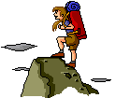
Wind is caused by
the unequal heating
of the earth!

Slide 2

Important fact!
Wind is always named by where it is coming from!
What would a wind be named (North or South) if it is blowing from Georgia to Florida?
It is called a NORTH wind because it is moving from the north to the south.

Slide 3
Two main types of wind:
1. Local - small area
2. Global - across continents due to
the Coriolois effect

Slide 4


Local winds
Most often noticed at the beach!

Slide 5
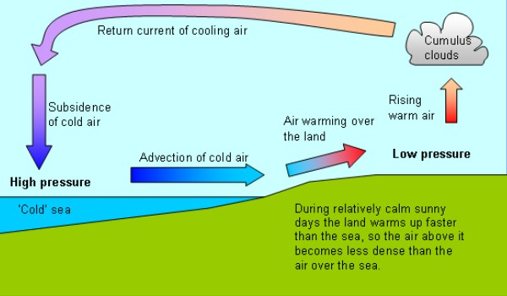
Sea Breeze
http://www.coolweather.co.uk/
Land heats up faster than water.
Warm air over land rises.
Air over water moves to shore.
Would occur during the day.
Named a SEA breeze because it comes from the sea.

Slide 6
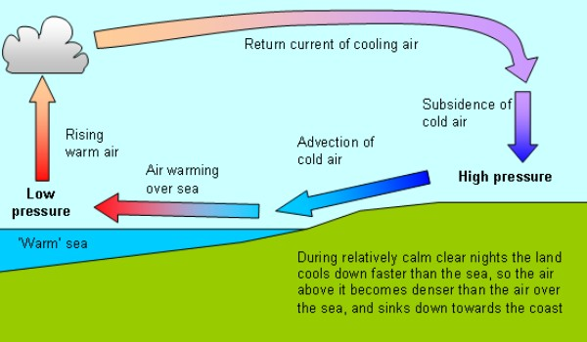
Land Breeze
http://www.coolweather.co.uk/
Land cools off faster than water.
Warm air over water rises.
Cool air from land takes its place.
Would occur at night.
Called a LAND breeze because the wind is coming from the land.

Slide 7
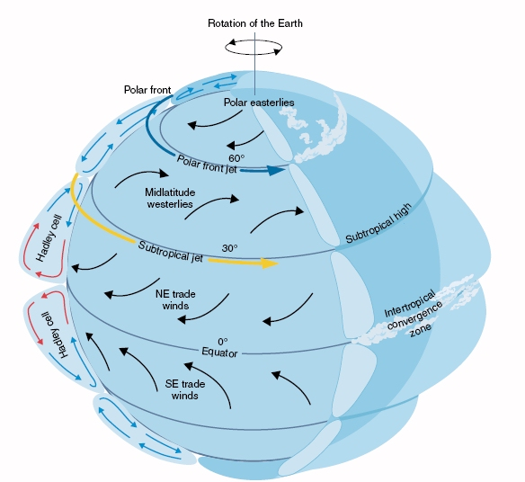
Global winds
1. Blow steadily from the same direction all the time.
2. The path is curved because of the Coriolis Effect.
http://cimss.ssec.wisc.edu

Slide 8
3. Types of Global Winds
Polar easterlies
Westerlies
Trade winds

Slide 9
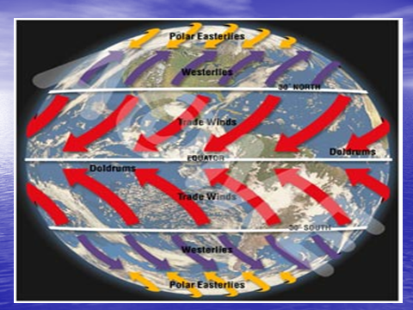

Slide 10
Remember!
Winds are named according to where originate, or come from.

Slide 11
Polar Easterlies
From the POLES
Wind belts that extend from the poles to 60° latitude
Formed from cold sinking air moving from the poles creating cold temperatures

Slide 12
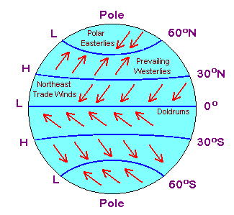

Slide 13
Westerlies
Wind belts found between 30° and 60° latitude
Flow towards the poles from west to east carrying moist air over the Unites States

Slide 15
Trade Winds
Winds that blow from 30° almost to the equator
Called the trade winds because of their use by early sailors

Slide 17
Jet
Streams

Slide 18
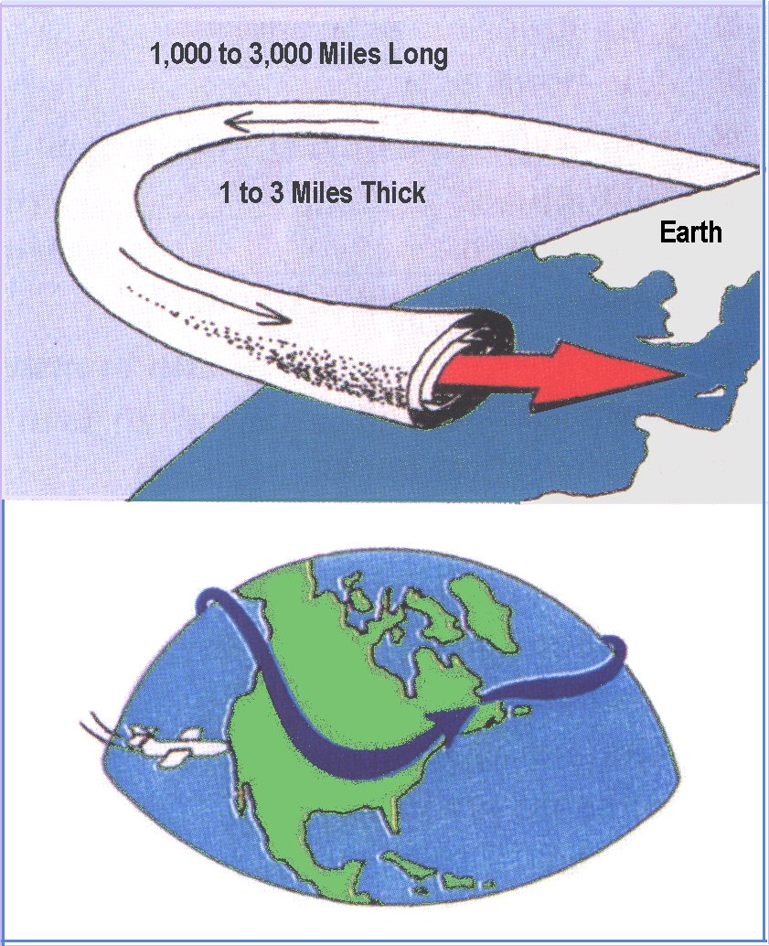
Jet Stream
Very fast 200-400 kmh
Acts like a conveyor belt
Goes completely around the earth.
In US, it makes
weather generally blow from west to east
Measured by anemometer

Slide 19
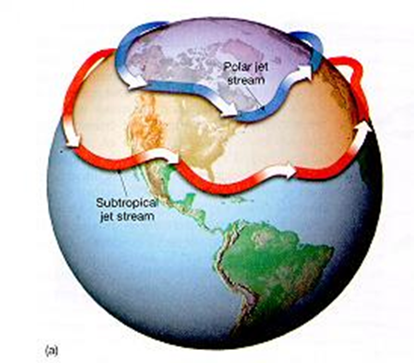

Slide 20
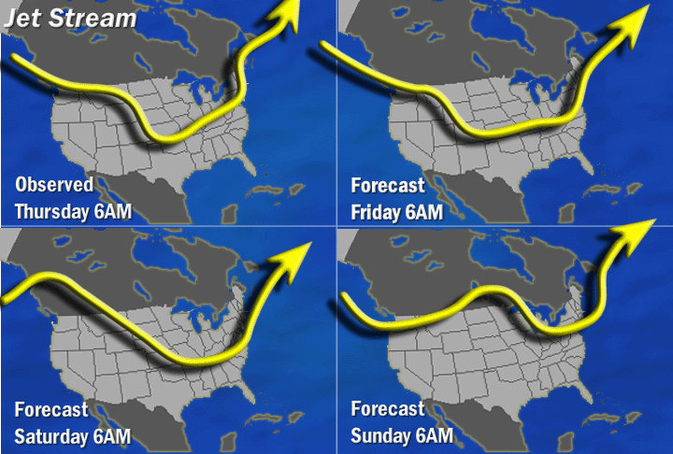
Notice that the jet stream does not stay the same every day. But it is always there!

Slide 21
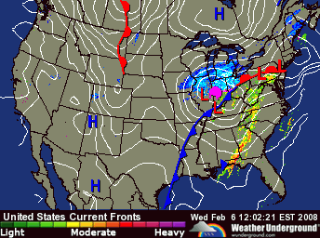
Notice on this weather map in motion how the rain moves toward the east over time.

